Slide 1
CAPSTONE PROJECT
Python program for movie Ticket booking
Presented By:
Sinciah Jaccob
Department of Textile Technology
Alagappa college of Technology Anna University

Slide 2
OUTLINE
Problem Statement
Proposed System/Solution
System Development Approach
Algorithm & Deployment
Result
Conclusion
Future Scope
References

Slide 3
PROBLEM STATEMENT
Design and implement a console-based movie ticket booking system in Python. The system should allow users to view available seats, book tickets, and display statistics such as the number of purchased tickets and total income.

Slide 4
PROPOSED SOLUTION
The program begins by defining a `MovieTicketBooking` class, which encapsulates the functionality of the movie ticket booking system. Upon initialization, the class takes two parameters: the number of rows (`rows`) and the number of seats per row (`seats_per_row`). It initializes the seating plan (`seating_plan`) as a 2D list of strings representing each seat's status, with `'S'` indicating an available seat.
The class also tracks the total number of seats (`total_seats`), the current income (`current_income`), and the total potential income (`total_income`). The total income is calculated based on the pricing strategy specified in the problem statement.
The class provides several methods:
1. display_seats()
2. buy_ticket()
3. calculate_ticket_price()
4. show_statistics()
5. calculate_total_income()
The `main()` function serves as the entry point of the program. It prompts the user to enter the number of rows and seats per row, creates an instance of the `MovieTicketBooking` class, and then presents a menu-driven interface for users to interact with. Users can choose to display seats, buy tickets, view statistics, or exit the program. Input validation ensures that users provide valid choices and seat selections.

Slide 5
SYSTEM APPROACH
1. Requirements Analysis
2. Design:
User Interface Design
Data Structures Design
3. Implementation
Class Design
Input Validation
Business Logic
4. Testing
5. Refinement
6. Documentation
7. Deployment
8. Maintenance

Slide 6
ALGORITHM & DEPLOYMENT
Algorithm:
Initialization
User Interaction Loop
Ticket Booking Logic
Statistics Calculation
Deployment:
Local Deployment:
Deploy the Python program on a local machine for testing and development purposes.
Run the program from the command line or an integrated development environment (IDE) such as PyCharm or Visual Studio Code.
Server Deployment:
Deploy the Python program on a server for production use.
Choose a suitable server environment, such as a virtual private server (VPS) or cloud platform
Transfer the program files to the server and ensure proper file permissions.
Run the program as a background process or deploy it behind a web server using frameworks like Flask or Django for web-based access.
Monitoring and Maintenance:
Monitor the deployed program for any issues or errors using logging and monitoring tools.
Handle any user feedback or feature requests by making necessary modifications to the program.

Slide 7
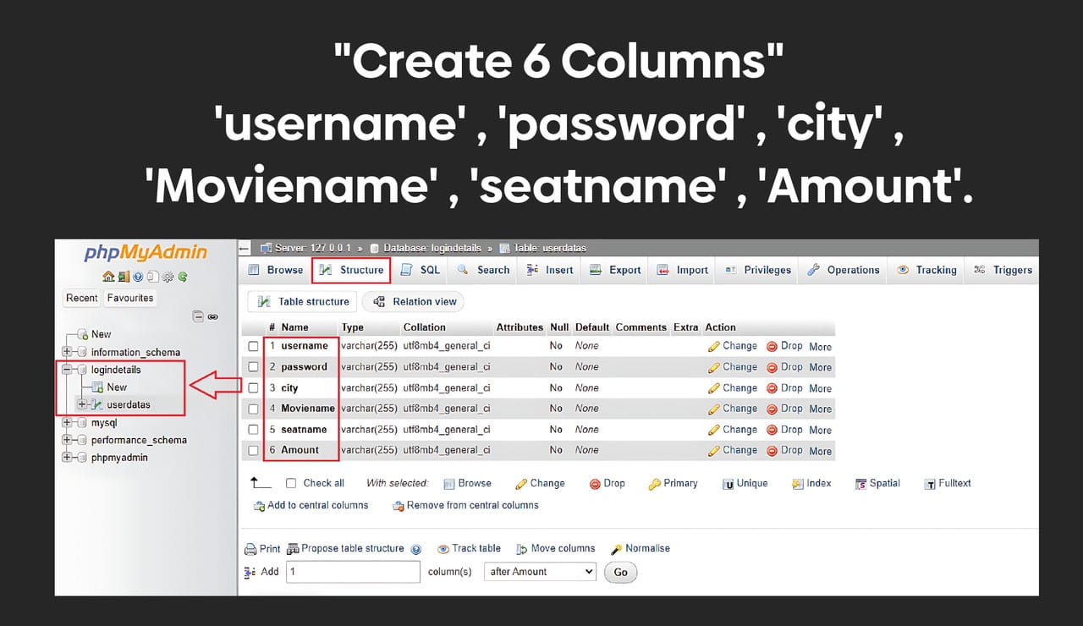
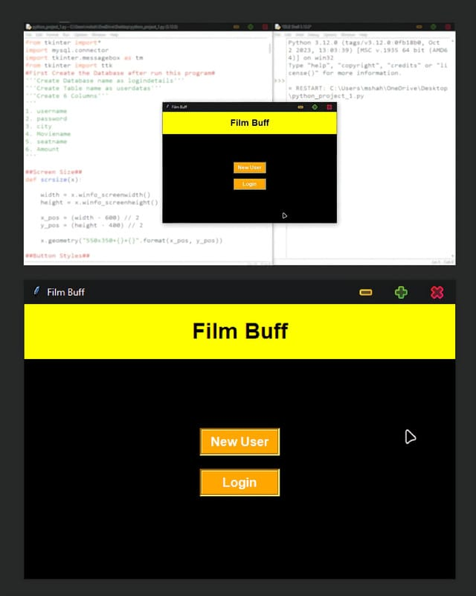
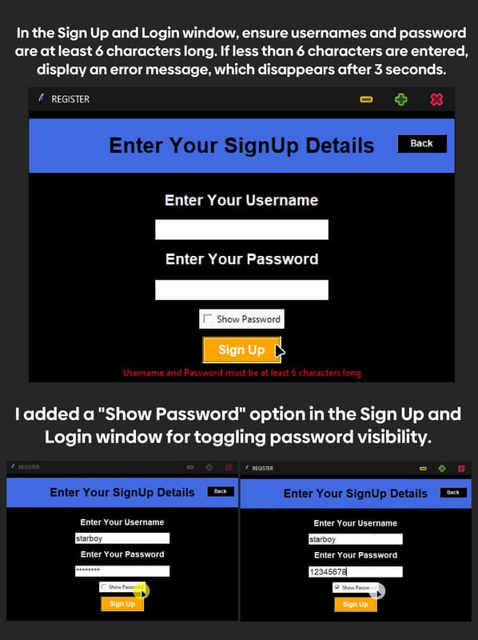
RESULT

Slide 8
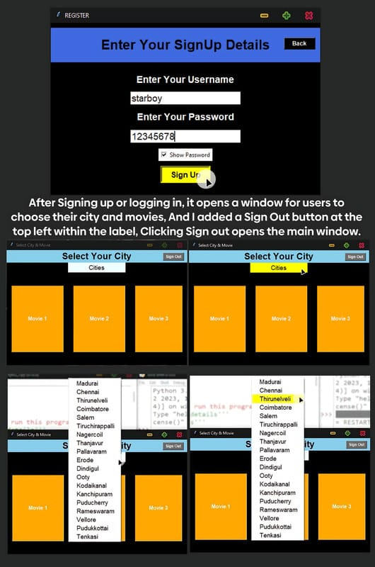
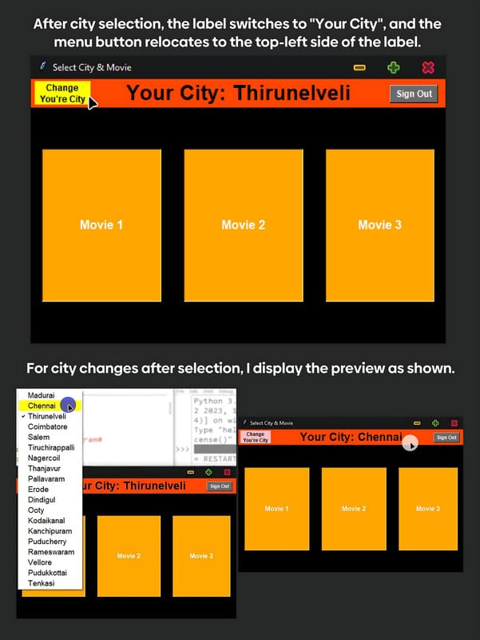
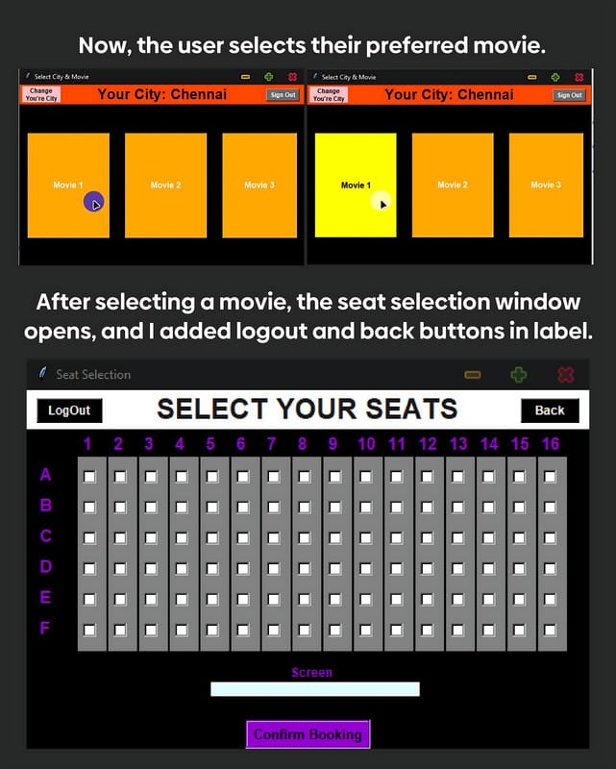

Slide 9
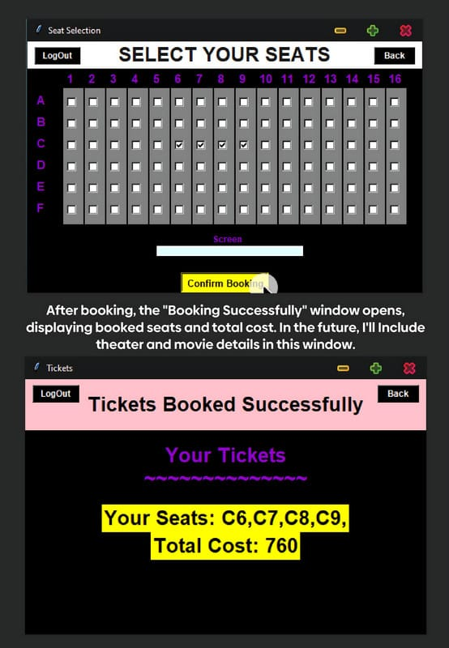
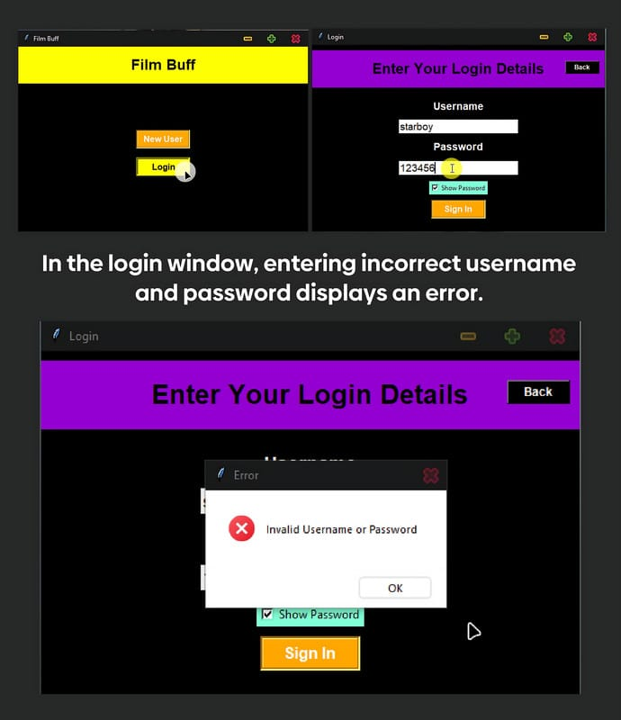
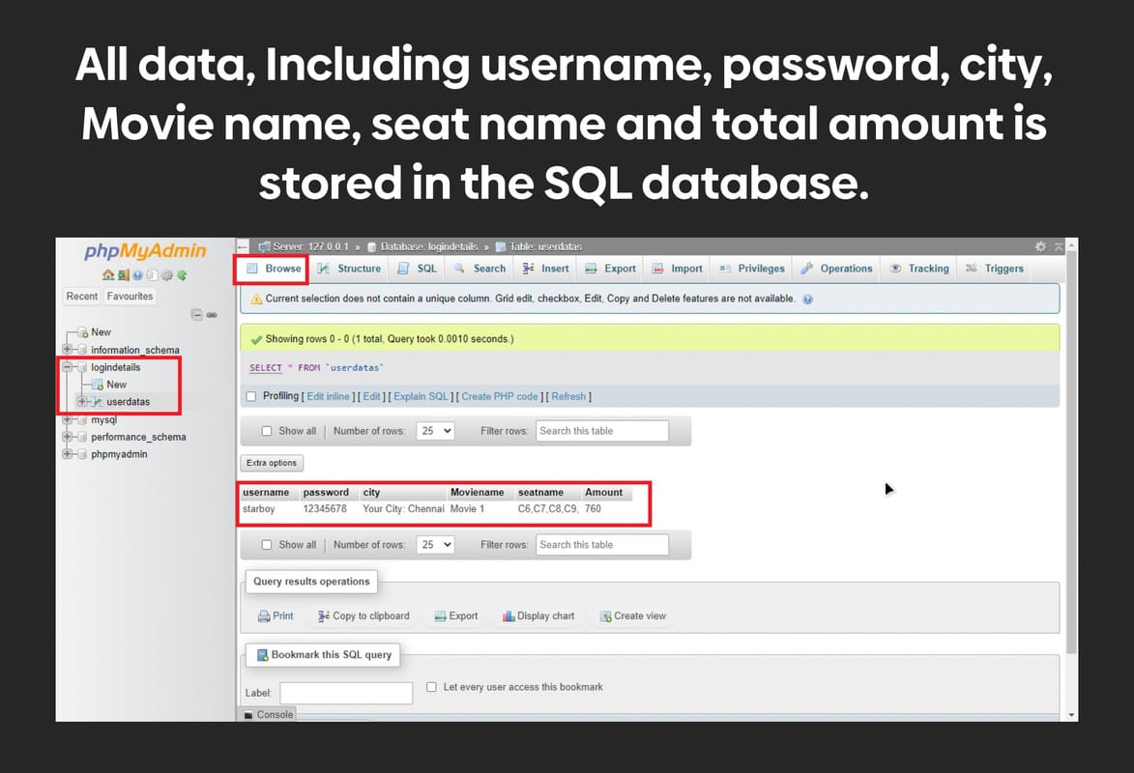

Slide 10
CONCLUSION
The ticket booking Python program provides a robust and user-friendly solution for managing movie ticket bookings. Through careful design, implementation, and deployment, the program offers the following benefits:
Efficient Booking Process
Accurate Pricing Strategy
Comprehensive Statistics
Flexible Deployment Options

Slide 11
FUTURE SCOPE
Integration with Online Platforms:
Explore integrating the ticket booking system with online platforms and mobile applications to reach a wider audience.
Implement features such as online ticket reservations, digital ticket delivery, and secure payment gateways to offer a seamless booking experience.
Personalized Recommendations:
Incorporate machine learning algorithms to analyze user preferences and booking history.
Provide personalized movie recommendations, special offers, and discounts to enhance user engagement and satisfaction.
Real-time Seat Availability Updates:
Implement real-time updates for seat availability to ensure accurate information for users.
Use push notifications or alerts to inform users about seat availability, last-minute promotions, or schedule changes.
Enhanced Analytics and Reporting:
Expand the statistics module to provide more detailed insights into booking trends, revenue generation, and customer demographics.
Generate comprehensive reports and visualizations to help theater owners make data-driven decisions and optimize business operations.

Slide 12
THANK YOU

